Slide 1
ENGINEERING PHYSICS
Unit 1: Wave Optics: Interference and Diffraction of Light

Slide 2
Lecture No : 4
Wedge Shaped Film
Lecture 5 : Wave Optics: Interference and Diffraction of Light

Slide 3
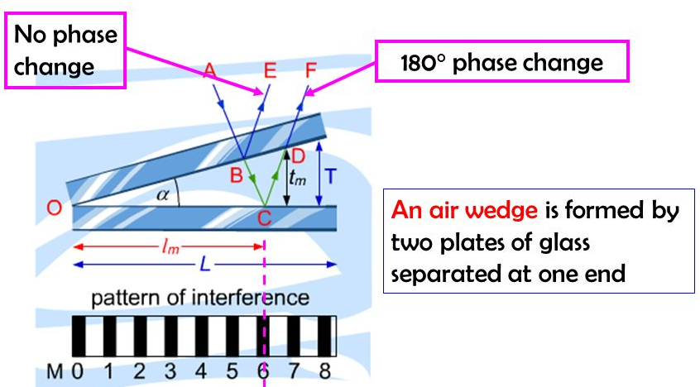

Film of Varying thickness (Wedge shaped Film )

Slide 4
Optical path difference in a wedge film
The Optical path difference between reflected ray and refracted ray is
Δ = ( BC + CD ) µ - BE
By Snell’s law sini/sinr = µ ; BE/BD = µ
BF/BD
Δ = ( BF + FC + CD – BF ) µ
Δ = ( FC + CD ) µ = 2 µ t cos (r + θ )

Slide 5
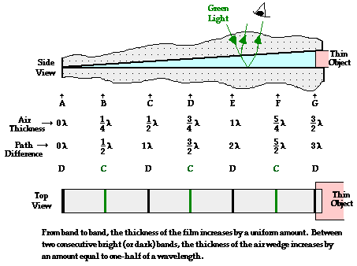
Wedge Shaped Film: (Interference Fringes)
For constructive interference
  2 μ t cos (r + θ ) = (2n±1) λ/2 n = 0, 1, 2 …
For destruction interference
  2 μ t cos (r + θ )= n λ n = 0, 1, 2 …

Slide 6
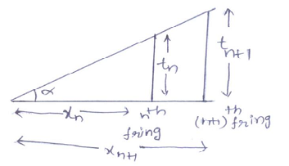
Band width or Fringe width (β)
The distance between any two consecutive dark or bright interference band is called Band width or Fringe width.
θ

Slide 7
Band width or Fringe width (β)
Consider an n^{th} dark band at a distance x_{n} from the edge of a wedge where , thickness of film is t _{n} .
  OPD 2 μ t _{n} cos (r + θ )= n λ n = 0, 1, 2 …
  From figure t _{n} = x_{n} tanθ
  ………..(1)
  Similarly for next dark band (n+1) at a distance x_{n +1} from the edge of a wedge where, thickness of film is t _{n+1}
  2 μ x_{n +1} tanθ cos (r + θ )=( n+1 )λ ………(2)
  From Equation (2) – (1) ……….. 2 μ (x_{n} — x_{n +1} ) sin θ =[( n+1 ) –n ]λ
  where (x_{n} — x_{n +1} ) is called band width β ; 2 μ (β) sin θ = n λ
2 μ x_{n} tanθ cos (r + θ )= n λ
β = n λ / 2θ
β = λ / 2 µ θ
As λ, µ, θ are constant ,β is constant. Therefore interference fringes are equidistant.

Slide 8
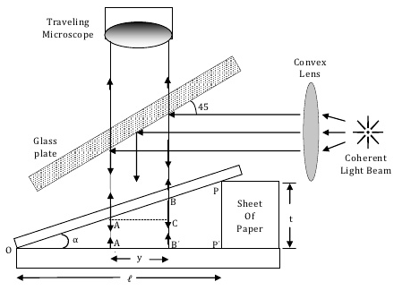
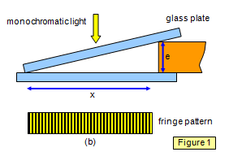
Thickness of Paper or thin wire or hair (application):

Slide 9

Questions and Source Materials
What do you mean by fringe and why fringes are straight line/bands wedge shape film??
Think about few applications where we can apply wedge shape film in engineering and what will be advantages of it over conventional methods?
Video Lectures
https://nptel.ac.in/courses/122/107/122107035/
https://www.youtube.com/watch?v=WTxDyYHaYAI
https://www.youtube.com/watch?v=zYJssqt2MXk
Lecture 4: Wedge shaped thin film

Slide 10
Lecture No : 5
Newton’s Rings
Lecture 5 : Wave Optics: Interference and Diffraction of Light

Slide 11
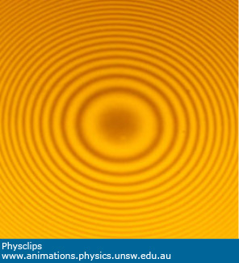
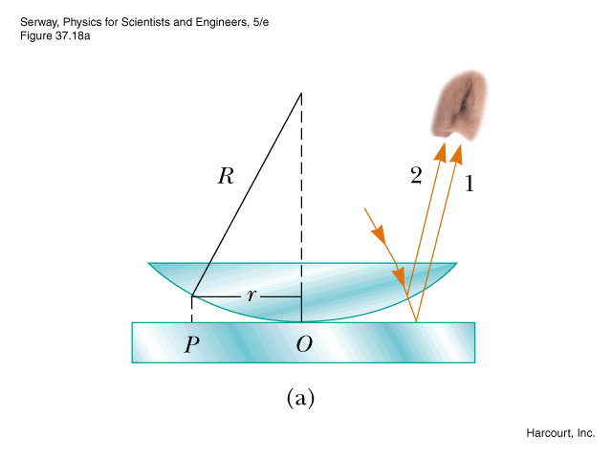
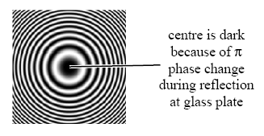
Newton’s Rings
The Newton’s Rings are observed when a Plano - convex lens of large radius of curvature is placed on a plane glass plate.

Slide 12
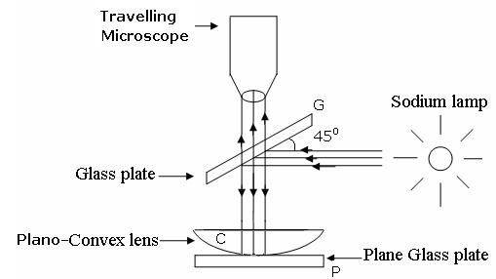
Newton’s Rings experimental setup

Slide 13
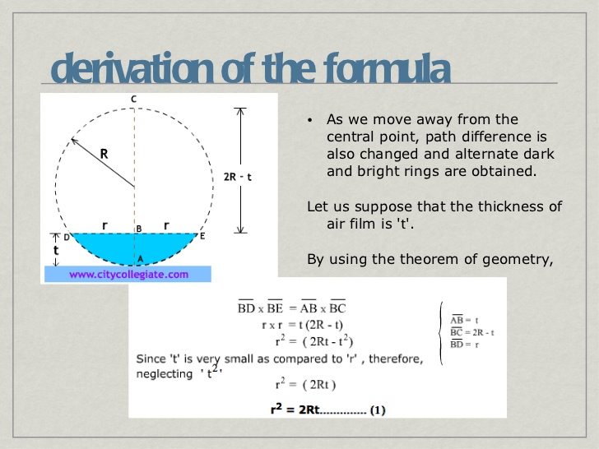

Derivation for thickness t_{n} of film

Slide 14
Radii of dark and bright rings
For destruction interference
  2 μ t cos r = n λ n = 0, 1, 2 …
  For normal incidence ∠r=0° 2 μ t = n λ ……Dark ring
  Using relation r² _{dark} _{= 2Rt}
  _{r dark = √ n λ R} ...... n = 0, 1, 2 … Thus radii of the dark rings are proportional to the square root of natural numbers.
  For bright rings r²_{bright} = (2n+1)λR/2
  r_{bright} = √ (2n+1)λR/2 ...... n = 0, 1, 2 … Thus radii of the bright rings are proportional to the square root of odd numbers.

Slide 15
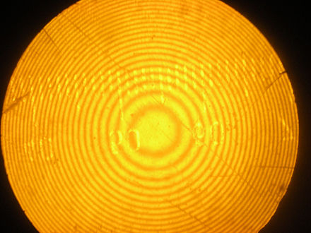
Newton’s Rings under transmitted light
Newton’s Rings in transmitted light gives complimentary pattern to those seen in Reflected light.
OPD = 2µt*cos(r)
r_{dark}= √ (2n+1)λR/2 ...... n = 0, 1, 2 … Thus radii of the dark rings are proportional to the square root of odd numbers
r_{bright = √ n λ R} ...... n = 0, 1, 2 … Thus radii of the bright rings are proportional to the square root of natural numbers .
Centre is bright because of no phase change of π on reflection from glass plate

Slide 16
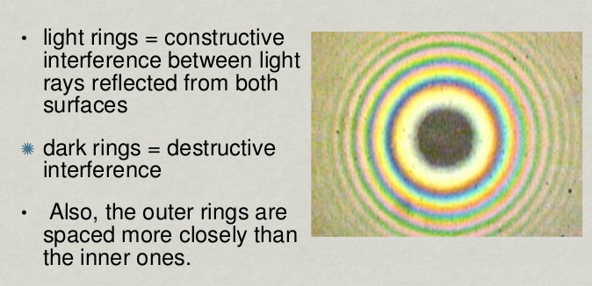
Newton’s Rings with white light

Slide 17
Newton’s Rings experimental setup

Slide 18

Determination of wavelength of source
The monochromatic light is made incident on the plano-convex lens and the reflected light is viewed in travelling microscope. Microscope is adjusted till the circular rings came in focus. Now the microscope crosswire is focused on the central dark spot and is moved slowly at one side, say right side. As the cross – wire moves in the field of view, dark rings are counted. The movement is stopped when it reaches at the 22nd dark ring. The cross wire is moved in opposite side and stopped at 20th dark ring such that the vertical cross-wire is made tangential to the ring. Thus starting from 20th the microscope position is noted down for 18th, 16th, 14th, …..6th ring. The microscope is quickly moved to the left side of the ring pattern and the positions of microscope is again noted down for 6th, 8th, 10th,……..20th ring. The diameter of the n^{th} order ring is calculated by subtracting the left and right side position of the microscope. As we know that the square of diameter of n^{th} dark ring is
Therefore the square of diameter of (n+p)^{th} ring is
subtracting
Therefore,

Slide 19

Determination of Refractive Index of liquid
In order to determine the refractive index of liquid the Newton’s ring experiment is first performed for the air medium and the difference in the square of the diameter of (n+p)^{th}and n^{th} dark ring is found as discussed above.
After this few drops of liquid of refractive index is placed on the glass plate. The plano-convex lens is then placed on the glass plate, as a result a film of liquid is formed between the lens and the plate.
The difference in the square of the diameter of (n+p)^{th} and n^{th} dark ring is again calculated in the same manner for the liquid medium.
Dividing equation , we get
µ = ——————

Slide 20
Questions and Source Materials
What do you mean by fringe and why fringes are straight line/bands wedge shape film??
Think about few applications where we can apply wedge shape film in engineering and what will be advantages of it over conventional methods?
Video Lectures
https://nptel.ac.in/courses/122/107/122107035/
https://www.youtube.com/watch?v=WTxDyYHaYAI
https://www.youtube.com/watch?v=zYJssqt2MXk
Lecture 4: Wedge shaped thin film

Slide 21
Unit No: 1 Unit name: : Interference in thin film
Lecture No : 6
Application of Interference

Slide 22
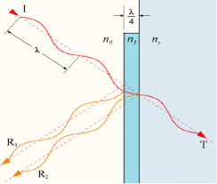
Antireflection Or Non Reflection Coatings ( A-R Coatings ):
R. I., µ_{a} < µ_{f} < µ_{g}
The refractive index of film should be less than that of glass µ_{f} = √ µ_{g}
180^{₀} complete destructive interference .
To satisfy this condition
Light travels exactly λ/2 path inside the film.
The OPD ∆ = 2 μ_{F} t cos (r ) = (2n +1)λ /2 ……for n=0, 1,2..
The minimum thickness of film coated on glass surface is t =λ/4 µ_{f}

Slide 23
Highly reflecting film
When R. I., µ_{f} > µ_{g}
For constructive interference for reflected rays.
The OPD
∆ = 2 μ_{f} t cos (r ) + λ /2= n λ
……for n=0, 1,2..
When, r =0, Normal incidence,
The minimum thickness of film coated on glass surface is
t =λ/4 µ_{f}

Slide 24
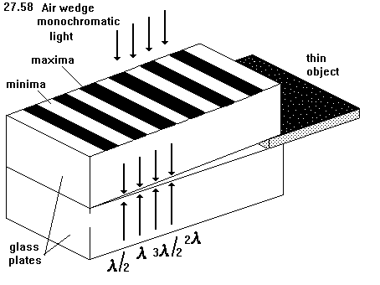
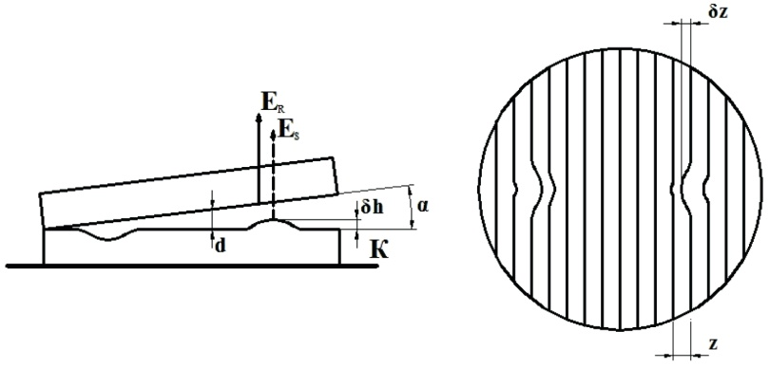
Testing of Surface flatness

Slide 25
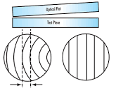
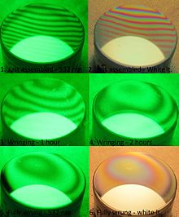
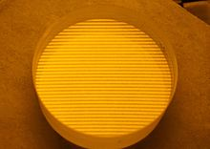
Testing of Surface flatness

Slide 26
Thank You

